Slide 1


Business Analyst Career Program
NAME:VISHAL PATHAK
BATCH: 6

Slide 2
INDEX
Project Summary.
Dataset Overview & Graphical Analysis using Excel.
Statistical Analysis using Excel.
Summarize, the Process of importing Data from and SQL database into Power BI involves
Insert the given Data in to the my SQL Server & Running Queries.
Create Power BI Dashboard.
Conclusion and Inferences.
Explore the Data using Excel and Prepare a short summary about the Dataset.

Slide 3
Here in this PPT presentation I am presenting:
Explore, Understand, Clean and Summaries the Data.
Statistical analysis with various Statistical tools.
Perform Graphical Analysis using Excel to Drive Insight.
Inserting Data in SQL Server and performing queries.
Importing Data in Power BI and Making Dashboard as required.
And Lastly , Deriving Conclusion and Inferences from the Dashboard.
All the Links for Source files will also be given where necessary for Reference. In the Presentation Will going to Provide Details Using Summaries, Graphs and Pictures.

Slide 4
Data Exploration and Graphical Analysis Using Excel

Slide 5
Explore the Data using Excel. Understand the data and prepare a short summary about the dataset.
A Business Analyst career program capstone project is a final, culminating task that demonstrates a student's proficiency and practical application of business analysis skills and knowledge gained throughout the program.
Business Analyst Career Program Capstone Project is the Final Project making completion of our Business Analyst Career Program And we are expected to complete the project by using our Analytical skill and Tools we have learned in the course. In this CAPSTONE PROJECT, I have provided Sales Data of Different Bicycles Brands in Canada, France, Germany, Mexico and USA. We expected to provide useful insight from the available data and Present in systematic manner as instructed in Project guideline.

Slide 6
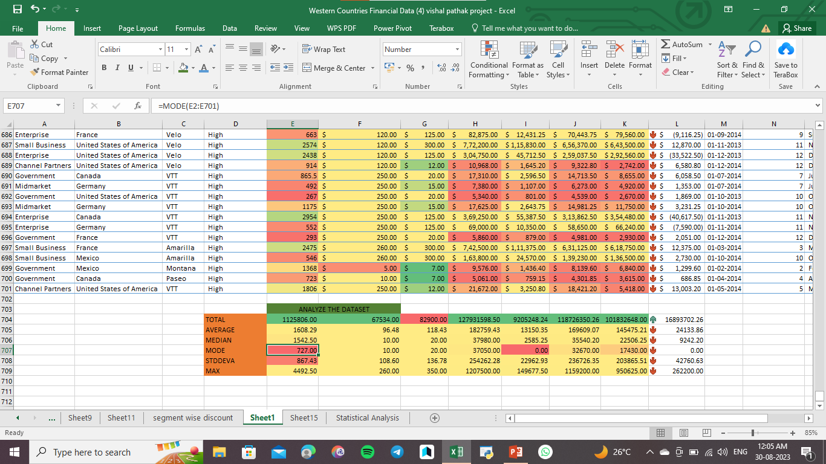
Analyse the dataset : use excel formula and function

Slide 7
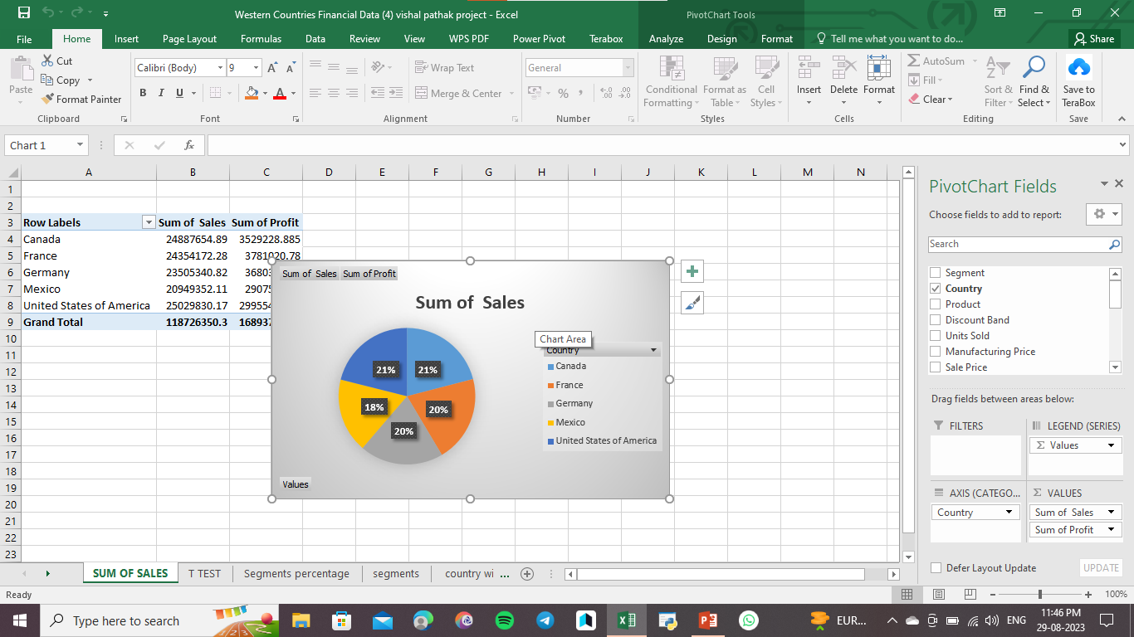
Analyse country wise sales: finding Canada and USA more sales

Slide 8
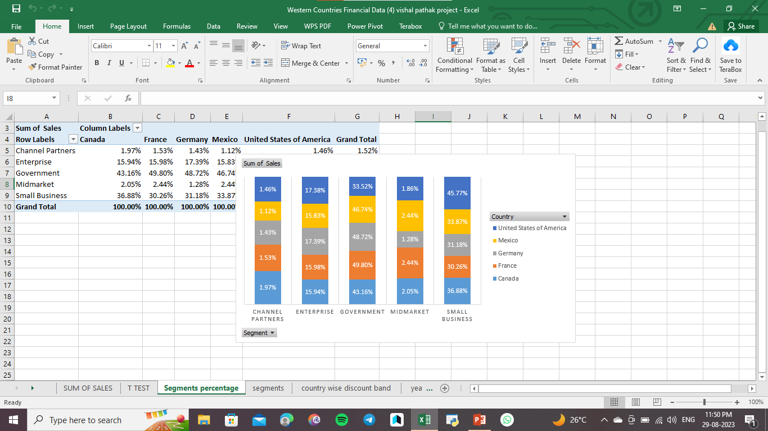
Canada , France , Germany , Mexico focus on government sector and USA focus on small business

Slide 9
STATISTICAL ANALYSIS USING EXCEL

Slide 10
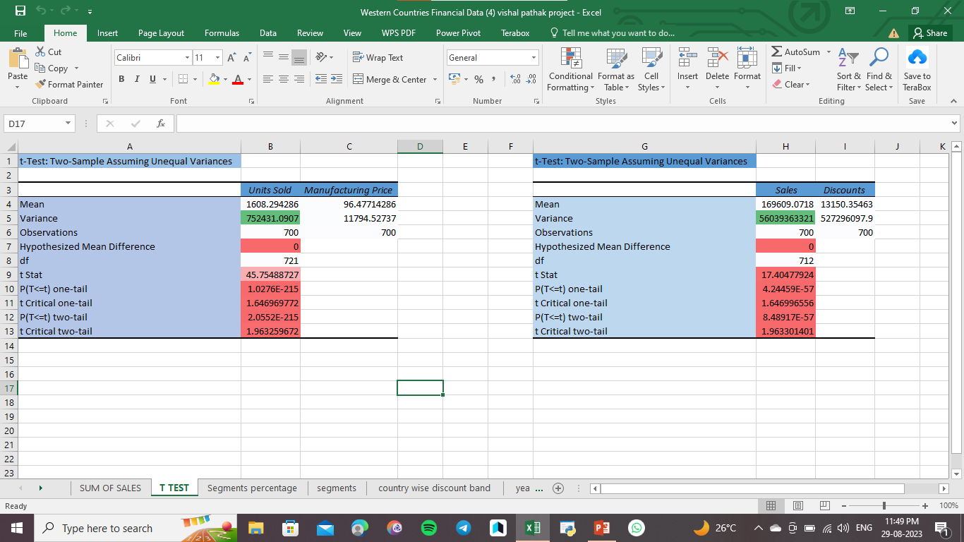
Here p value is smaller than alpha value than we conclue H1

Slide 11
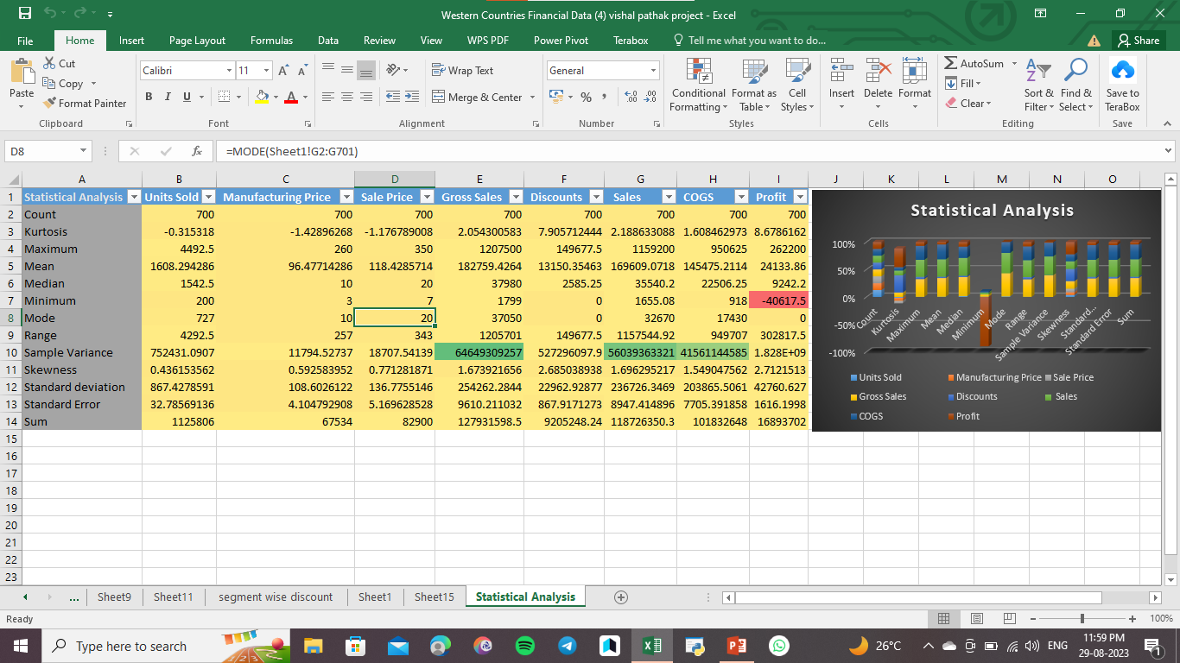
Statistical Analysis:

Slide 12
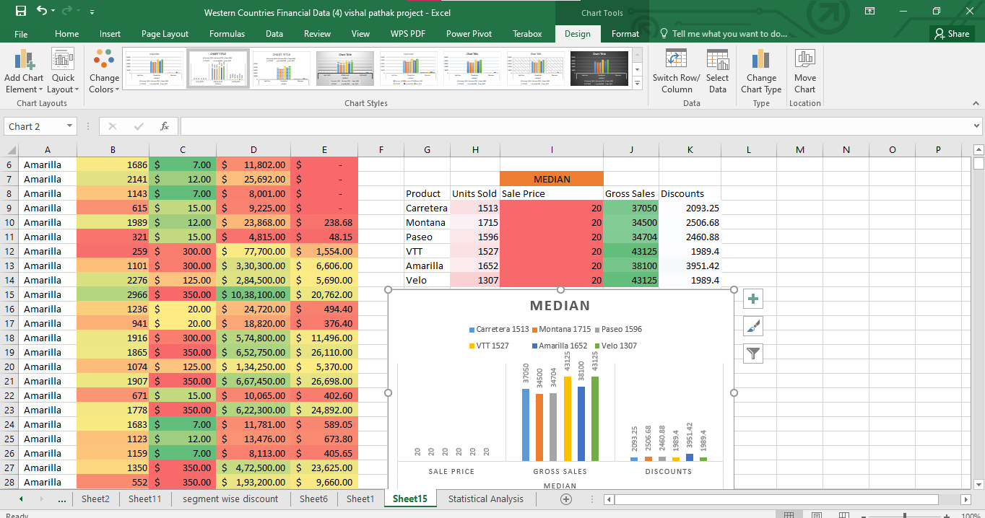
Median:

Slide 13
Graphical analysis
On the Data using
excel

Slide 14
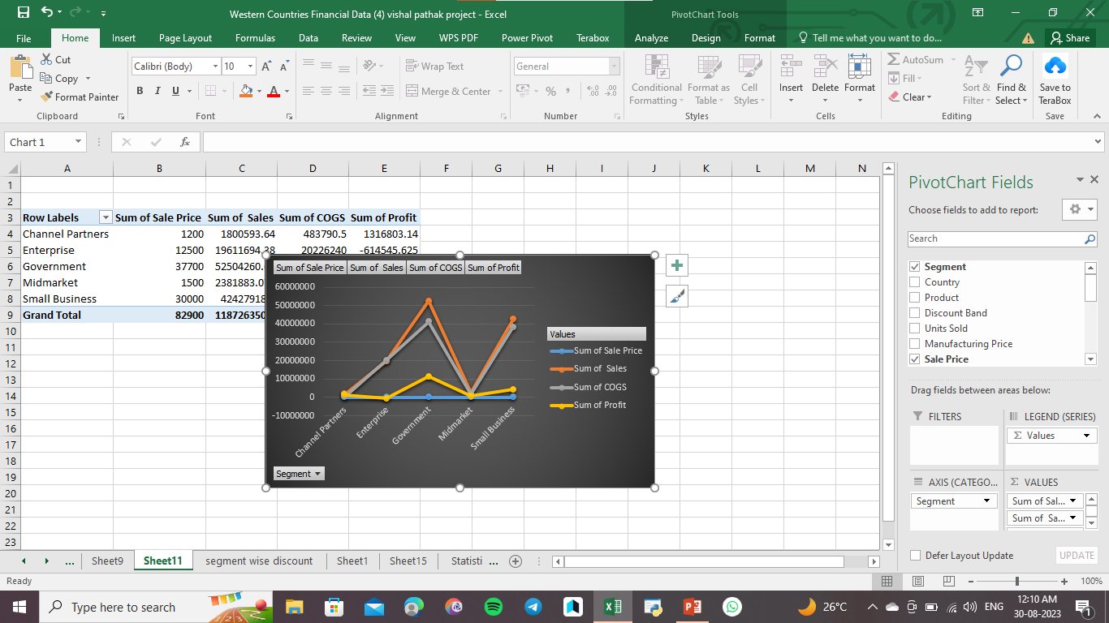
Biggest client government sector

Slide 15
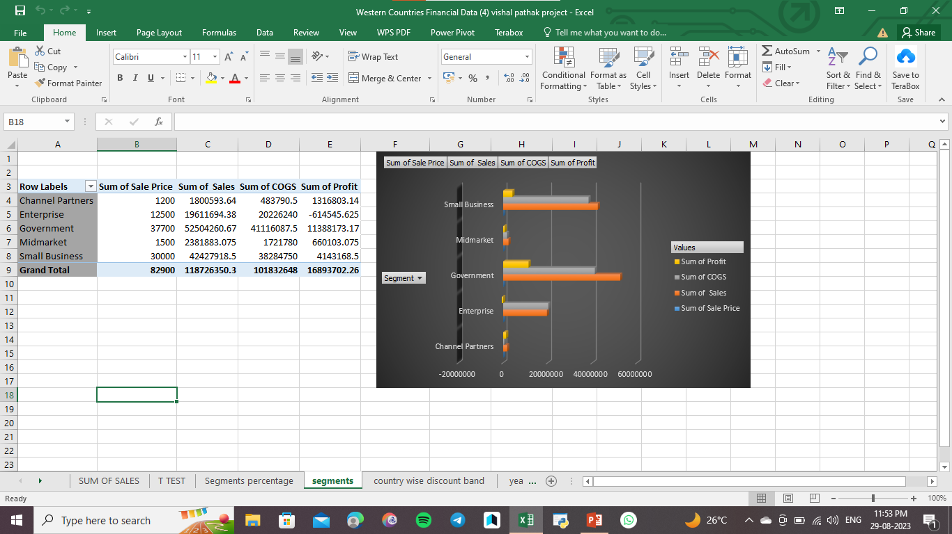

Slide 16
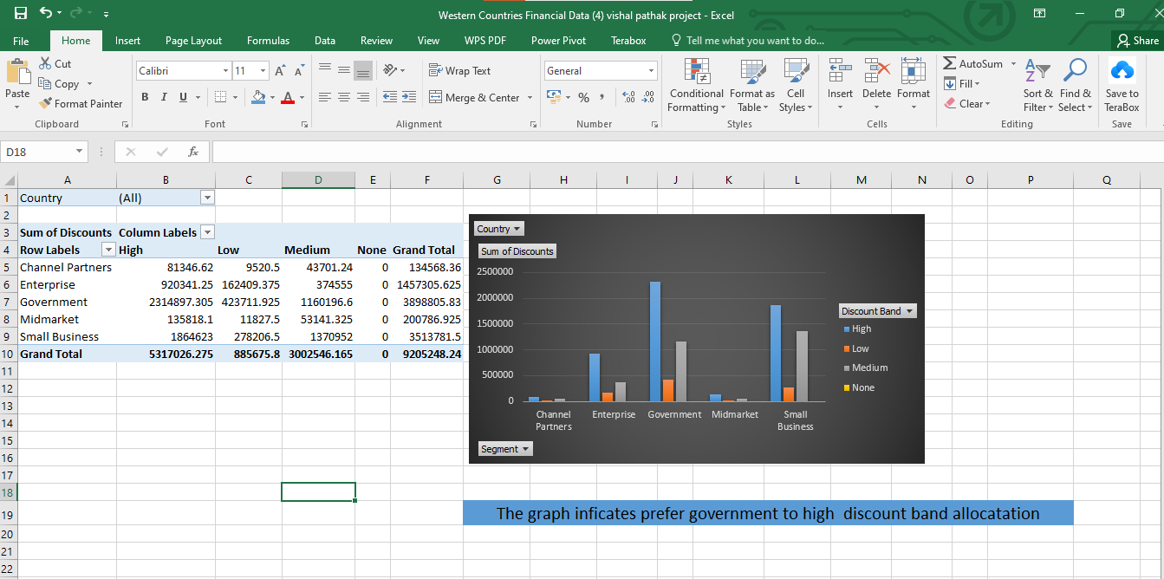

Slide 17
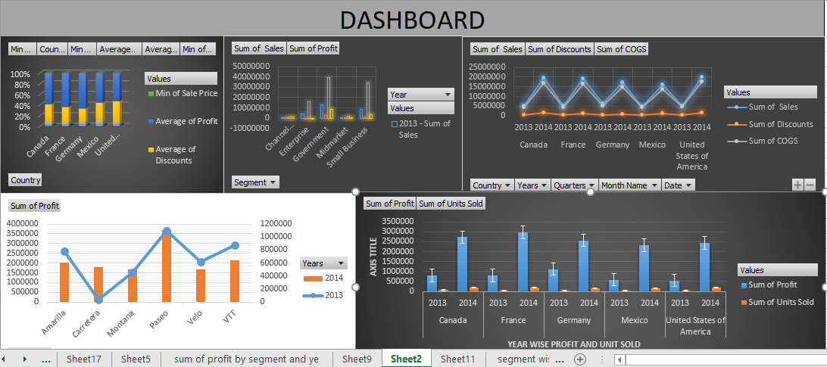
Perform Graphical Analysis on the Data using Excel and Derive insights from it.

Slide 18
INSERT THE GIVEN DATA CSV FILE INTO THE MYSQL
(RUNNING QUERIES)

Slide 19
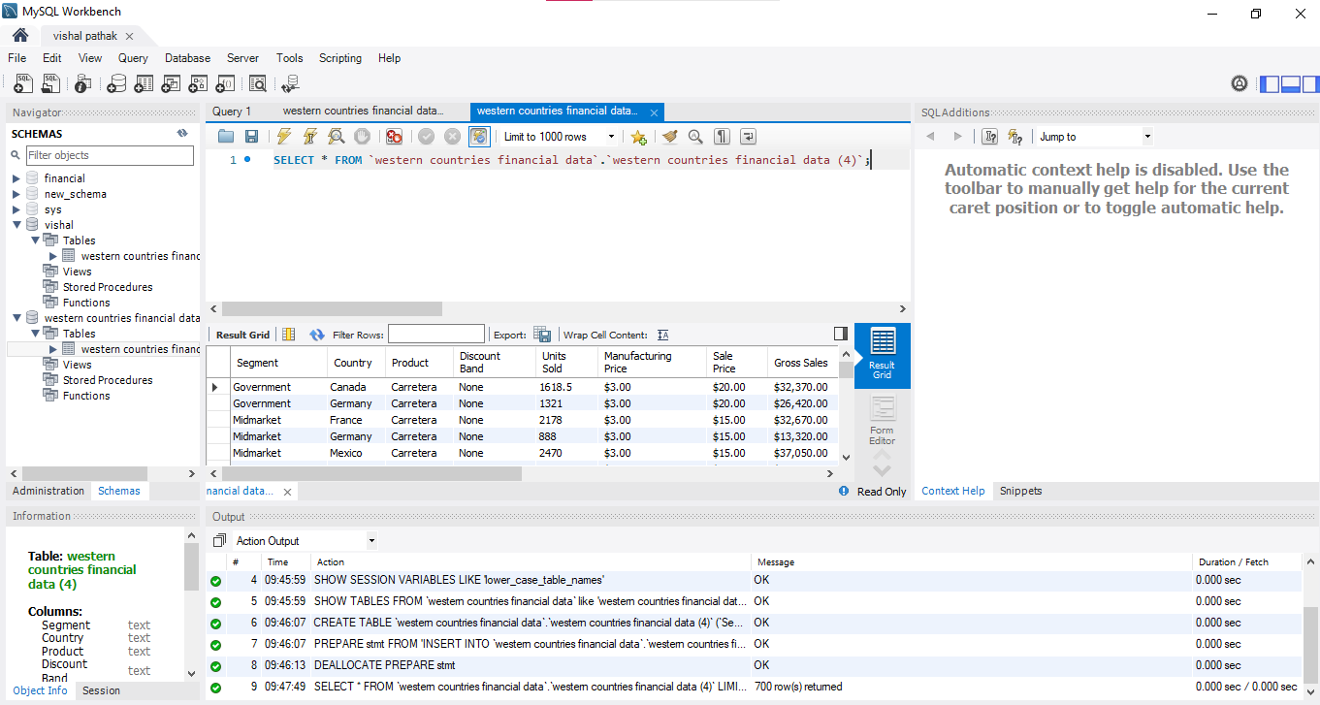

Slide 20
Interactive dashboard by using visualization
Tools (Power bi)

Slide 21
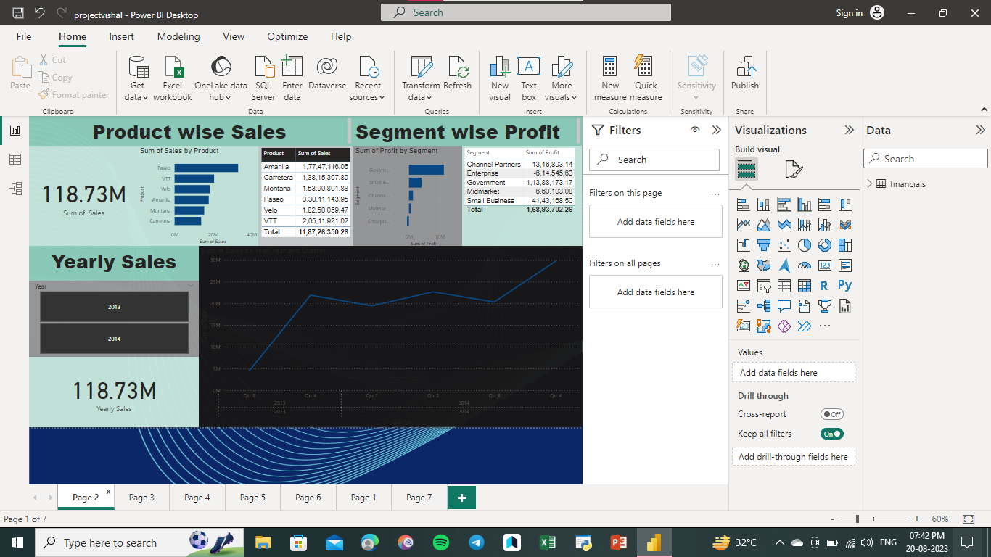

Slide 22
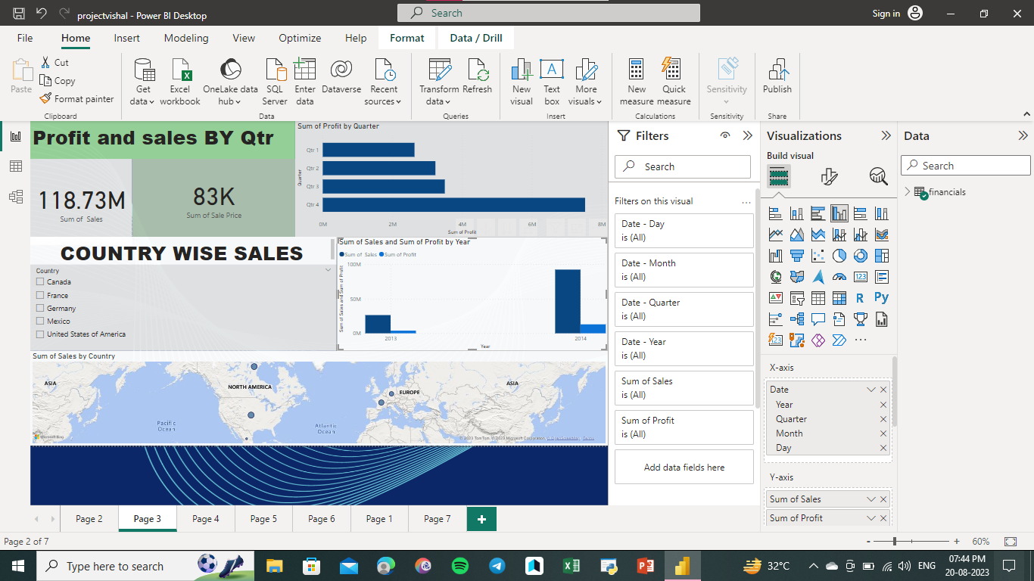

Slide 23
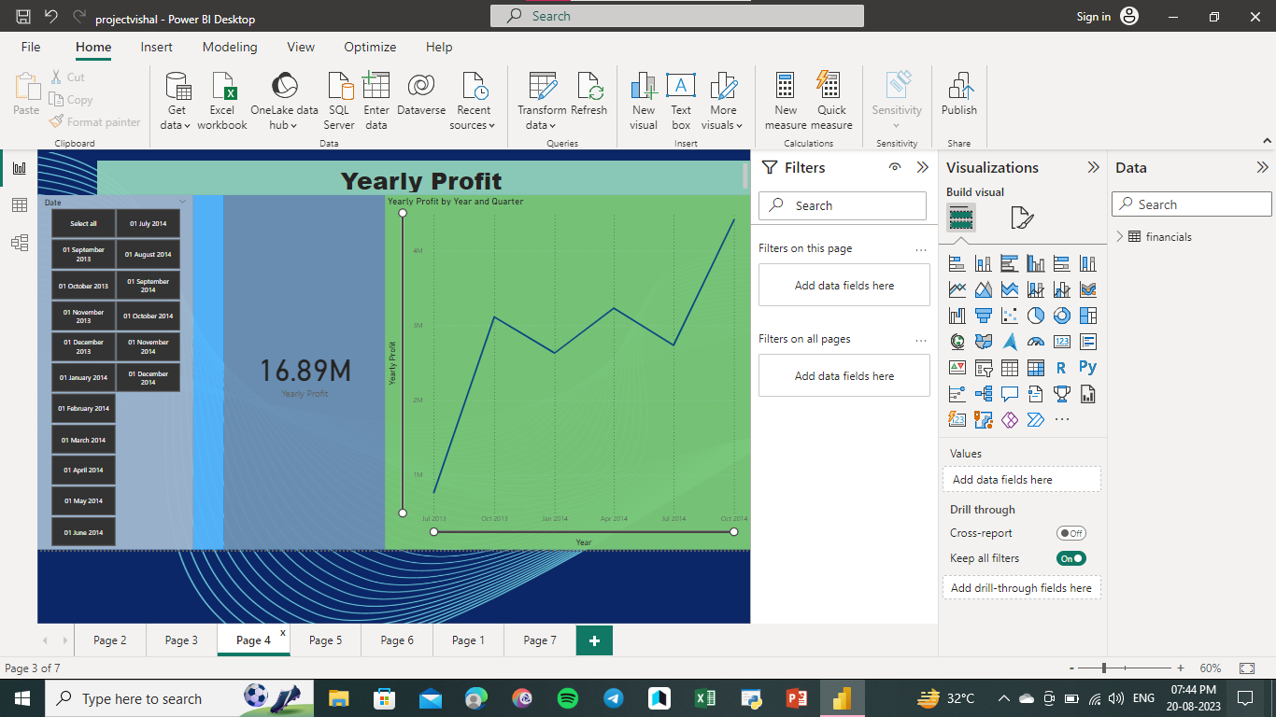

Slide 24
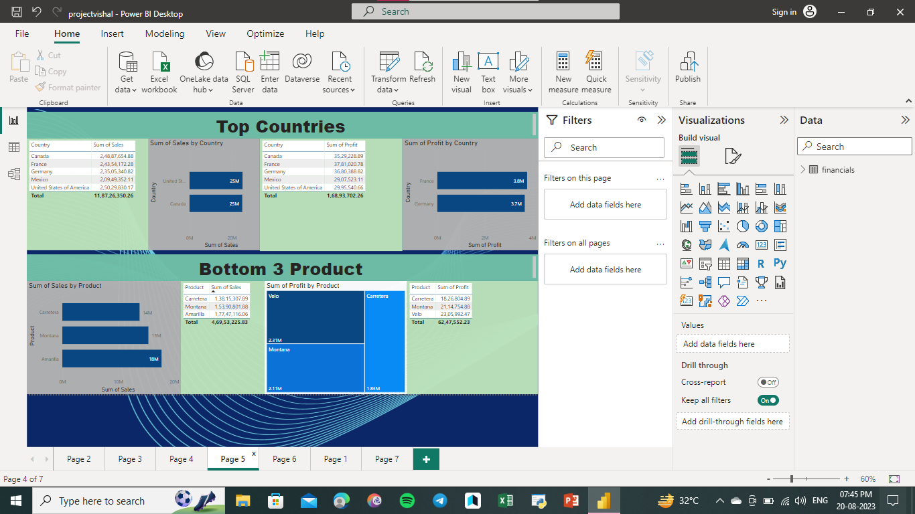

Slide 25
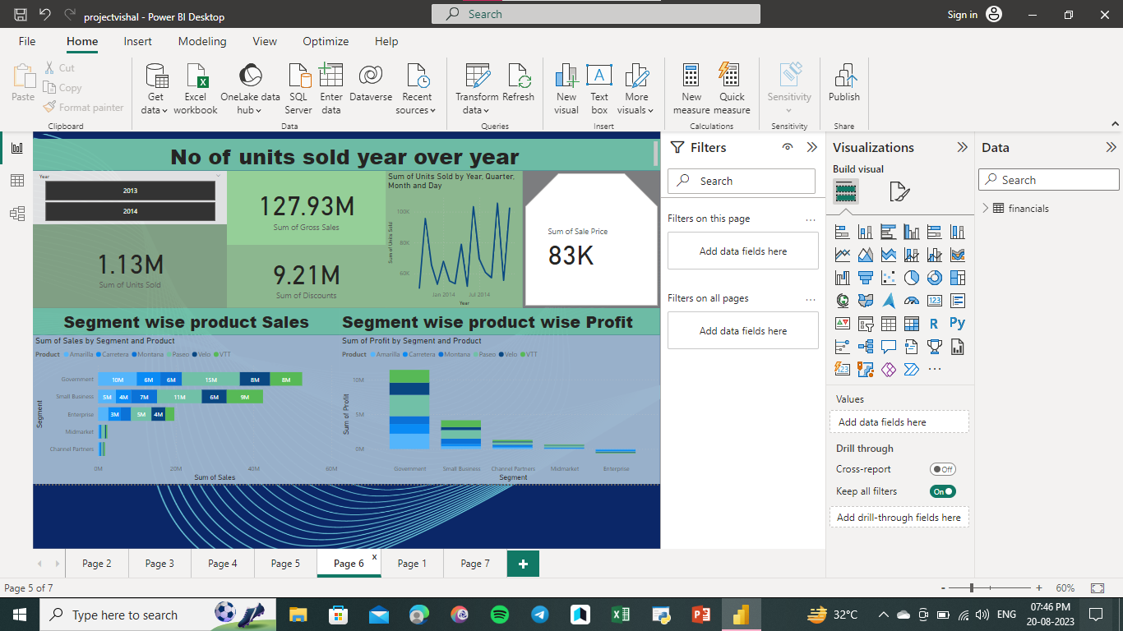

Slide 26
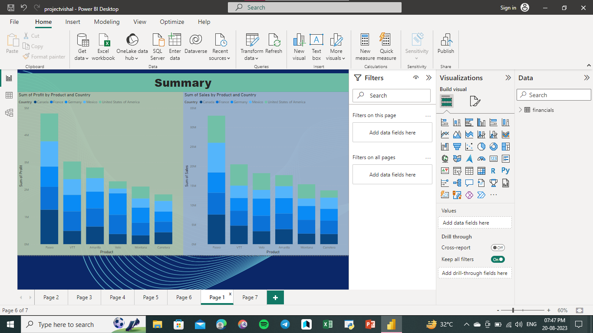

Slide 27
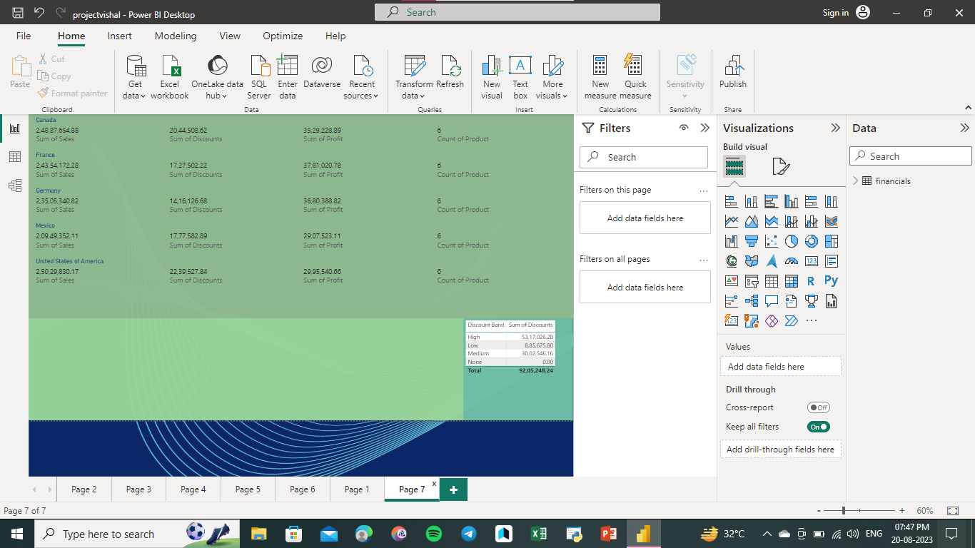

Slide 28
Project Summary

Slide 29
Create a Visually pleasing Dashboard report by following the rules of making the Dashboard. To explore and analyze the Western country data using Excel, you can follow these steps to create a project
Import the data: Obtain the dataset you want to analyze and save it in a suitable format (e.g., CSV, XLSX). Open Excel and importthe data into a new workbook by selecting "File"> "Open" or "File"> "Import.“
Data cleaning and formatting: Inspect the data for any inconsistencies, missing values, or formatting issues. Clean the data byremoving or filling in missing values, correcting errors, and ensuring consistent formatting for each column (e.g., dates, numbers,text).2.
Data exploration: Start exploring the dataset by examining the columns, their meanings, and the overall structure of the data. Use Excel's features such as sorting, filtering, and conditional formatting to gain initial insights. Generate summary statistics (e.g., mean, median, standard deviation) for numerical columns and calculate frequencies for categorical variables.
Data visualization: Create visualizations to better understand the data. Excel offers various chart types (e.g., bar charts, line charts, scatter plots) to visualize relationships between variables. Select appropriate charts based on the nature of the data and the insights you want to gain. For example, you can compare GDP growth rates across countries or visualize population trendsover time.
Statistical analysis: Perform statistical analysis to uncover relationships and patterns in the data. Excel provides a range of functions and formulas for calculations, such as correlations, regressions, and hypothesis testing. Utilize these tools to explore the dataset further and draw meaningful conclusions.
Interpretation and summary: Once you have explored and analyzed the data, summarize your findings. Identify key trends,patterns, and insights you have discovered during the analysis. Highlight any interesting observations or correlations you have encountered. Consider the context of the Western country dataset and relate your findings to the research or project objectives.
Data reporting: Present your findings in a concise and visually appealing manner. Create tables, charts, and graphs to showcase the most relevant information. Use Excel's formatting options to enhance the visual appearance of your report. Consider including captions, titles, and explanatory text to provide context for your visualizations.
Remember to save your Excel workbook periodically during the project to avoid data loss.

Slide 30
SUMMARY
Retrieve the necessary data from your SQL database using SQL queries in MySQL Workbench.
Export the retrieved data as a CSV file from MySQL Workbench. To do this, right-click on the query result grid and choose "Export Result Set" or a similar option. Select the CSV format and provide a file name for the exported data.
Open PowerPoint and create a new presentation.
Navigate to the "Insert" tab and choose "Table" to insert a table into your slide.
In the "Insert Table" dialog box, specify the number of rows and columns that match your data.
Open the exported CSV file containing your SQL Workbench data.
Select all the data in the CSV file (Ctrl+A) and copy it (Ctrl+C).
Paste the copied data into the PowerPoint table by clicking in the top-left cell and selecting Paste" (Ctrl+V).
Customize the appearance and formatting of the table in PowerPoint as desired.
Repeat the above steps for any additional data or slides you want to include in your PowerPoint summary.

Slide 31
Summary
Dataset Description: Provide a brief description of the dataset, including the source of the data, the number of rows and columns, and the time period covered.
Key Variables: Identify the main variables or columns in the dataset that are relevant to the analysis and insights.
Data Insights: Summarize the main findings or insights obtained from the analysis. This may include trends, patterns, correlations, or anomalies discovered in the data.
Statistical Analysis: Highlight any statistical analysis performed on the data, such as descriptive statistics, measures of central tendency, variability, or hypothesis testing results if applicable.
Data Cleaning: Mention any data cleaning steps undertaken to address missing values, outliers, or inconsistencies in the dataset.

Slide 32
Summary
Graphical Analysis: Briefly describe the main graphical analyses conducted on the data, including charts, plots, or visualizations used to represent the data visually and derive insights.
Database Integration: Specify whether the dataset was successfully imported into the SQL database and verify if the data is properly stored in the tables.
Power BI Integration: Indicate if the data was imported into Power BI from the SQL database and if the integration was successful.
Data Cleaning and Visualization in Power BI: Mention any data cleaning steps performed in the Power BI Query Editor and describe the interactive visualizations created using Power BI tools.
Detailed Interactive Dashboard: Highlight the creation of a detailed interactive dashboard using visualization tools like Power BI, which provides insights and answers specific questions related to the dataset.

